Slide 1
MATHEMATICS GRADE 12
Grade 12 mathematics slides for challenging topics/chapters.

Slide 2
Limits & Continuity — Slide 1
  Definition of a Limit:
  A limit describes the value a function approaches as x approaches a point.
  Limit Laws:
  Sum rule, product rule, quotient rule, and power rule.

Slide 3
Limits & Continuity — Slide 2
  Techniques for Evaluating Limits:
  Direct substitution, factoring, rationalizing.
  One-Sided Limits:
  Left-hand and right-hand behavior.

Slide 4
Limits & Continuity — Slide 3
  Limits Involving Infinity:
  Vertical asymptotes, horizontal asymptotes.
  Continuity Definition:
  A function is continuous if lim f(x)=f(a).

Slide 5
Limits & Continuity — Slide 4
  Types of Discontinuities:
  Jump, removable, infinite.
  Intermediate Value Theorem:
  Guarantees existence of value between f(a) and f(b).

Slide 6
Limits & Continuity — Slide 5
  Limit of Rational Functions:
  Behavior depends on numerator/denominator degrees.
  L'Hôpital’s Rule (mention only):
  Used when forms are 0/0 or ∞/∞.

Slide 7
Limits & Continuity — Slide 6
  Graphical Interpretation:
  Limits represent intended height on the graph.
  Limit Examples:
  lim x→2 (x^2 - 4)/(x - 2)=4.

Slide 8
Limits & Continuity — Slide 7
  Piecewise Limits:
  Evaluate from both sides.
  Continuity on Closed Intervals:
  Endpoints require one-sided continuity.

Slide 9
Limits & Continuity — Slide 8
  Limit Existence:
  Equal left-hand and right-hand limits.
  Formal ε–δ Definition (basic outline):
  A precise way to define limits.

Slide 10
Limits & Continuity — Slide 9
  Trigonometric Limits:
  lim x→0 sinx/x=1.
  Polynomial Limits:
  Always continuous everywhere.

Slide 11
Limits & Continuity — Slide 10
  Rational Function Behavior:
  Undefined when denominator=0.
  Continuity Applications:
  Used in solving real-world problems.

Slide 12
Limits & Continuity — Slide 11
  Limits in Sequences:
  Values approached as n grows large.
  Growth Comparison:
  Exponentials grow faster than polynomials.

Slide 13
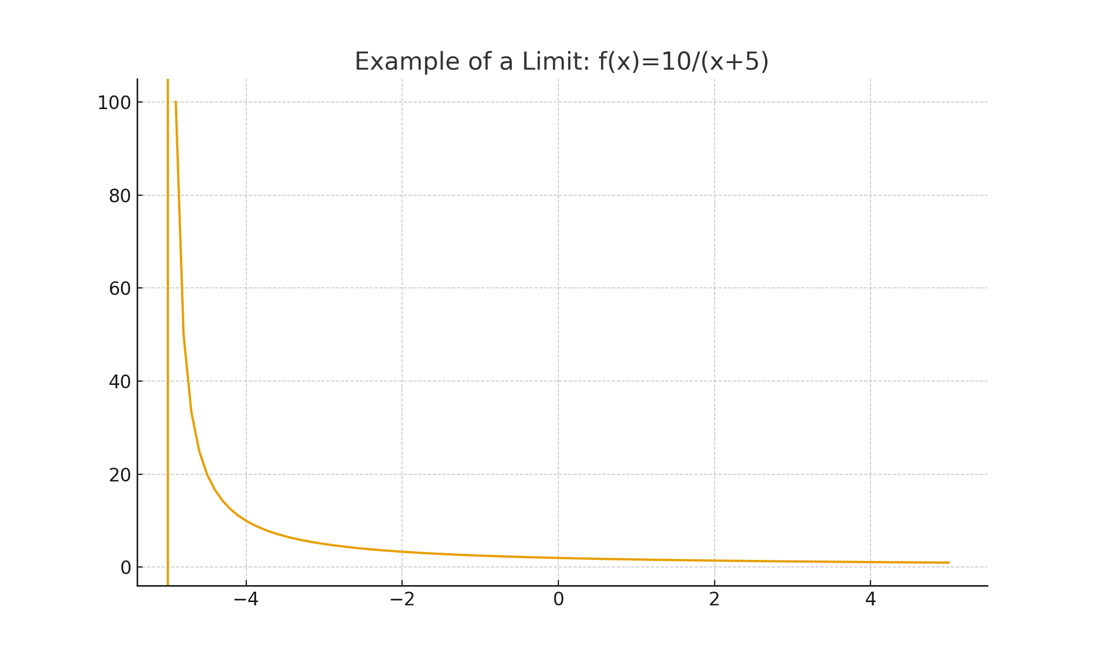
Limits & Continuity — Slide 12
  Limit Tables:
  Approximating limits numerically.
  Limit Graph Sketching:
  Shows tendencies near undefined points.
  Summary Slide:
  Limits describe approach, not actual value.

Slide 14
Differential Calculus — Slide 13
  Definition of a Derivative:
  Instantaneous rate of change.
  Notation:
  f'(x), dy/dx, d/dx[f(x)].
  Limit Definition:
  f'(x)=lim (f(x+h)-f(x))/h.

Slide 15
Differential Calculus — Slide 14
  Power Rule:
  d/dx(x^n)=nx^(n−1).
  Constant Rule:
  Derivative of constant is 0.
  Constant Multiple Rule:
  Derivative of c·f=c·f'.

Slide 16
Differential Calculus — Slide 15
  Sum and Difference Rule:
  Differentiate term-by-term.
  Product Rule:
  (uv)'=u'v+uv'.

Slide 17
Differential Calculus — Slide 16
  Quotient Rule:
  (u/v)'=(u'v−uv')/v².
  Chain Rule:
  Derivative of composite functions.
  Implicit Differentiation:
  Used when y is not isolated.

Slide 18
Differential Calculus — Slide 17
  Derivatives of Trig Functions:
  d/dx(sin x)=cos x.
  Derivatives of Exponentials:
  d/dx(e^x)=e^x.
  Derivatives of Logarithms:
  d/dx(ln x)=1/x.

Slide 19
Differential Calculus — Slide 18
  Higher-Order Derivatives:
  Second derivative indicates concavity.
  Equation of Tangent Line:
  Use point and slope f'(a).
  Linear Approximation:
  f(x)≈f(a)+f'(a)(x−a).

Slide 20
Differential Calculus — Slide 19
  Related Rates Basics:
  Rates connected by an equation.
  Critical Points:
  f'=0 or undefined.
  Concavity:
  f''>0 concave up; f''<0 concave down.

Slide 21
Differential Calculus — Slide 20
  Inflection Points:
  Where concavity changes.
  Derivative Applications:
  Slope, velocity, acceleration.
  Differentiability:
  Implies continuity but not vice versa.

Slide 22
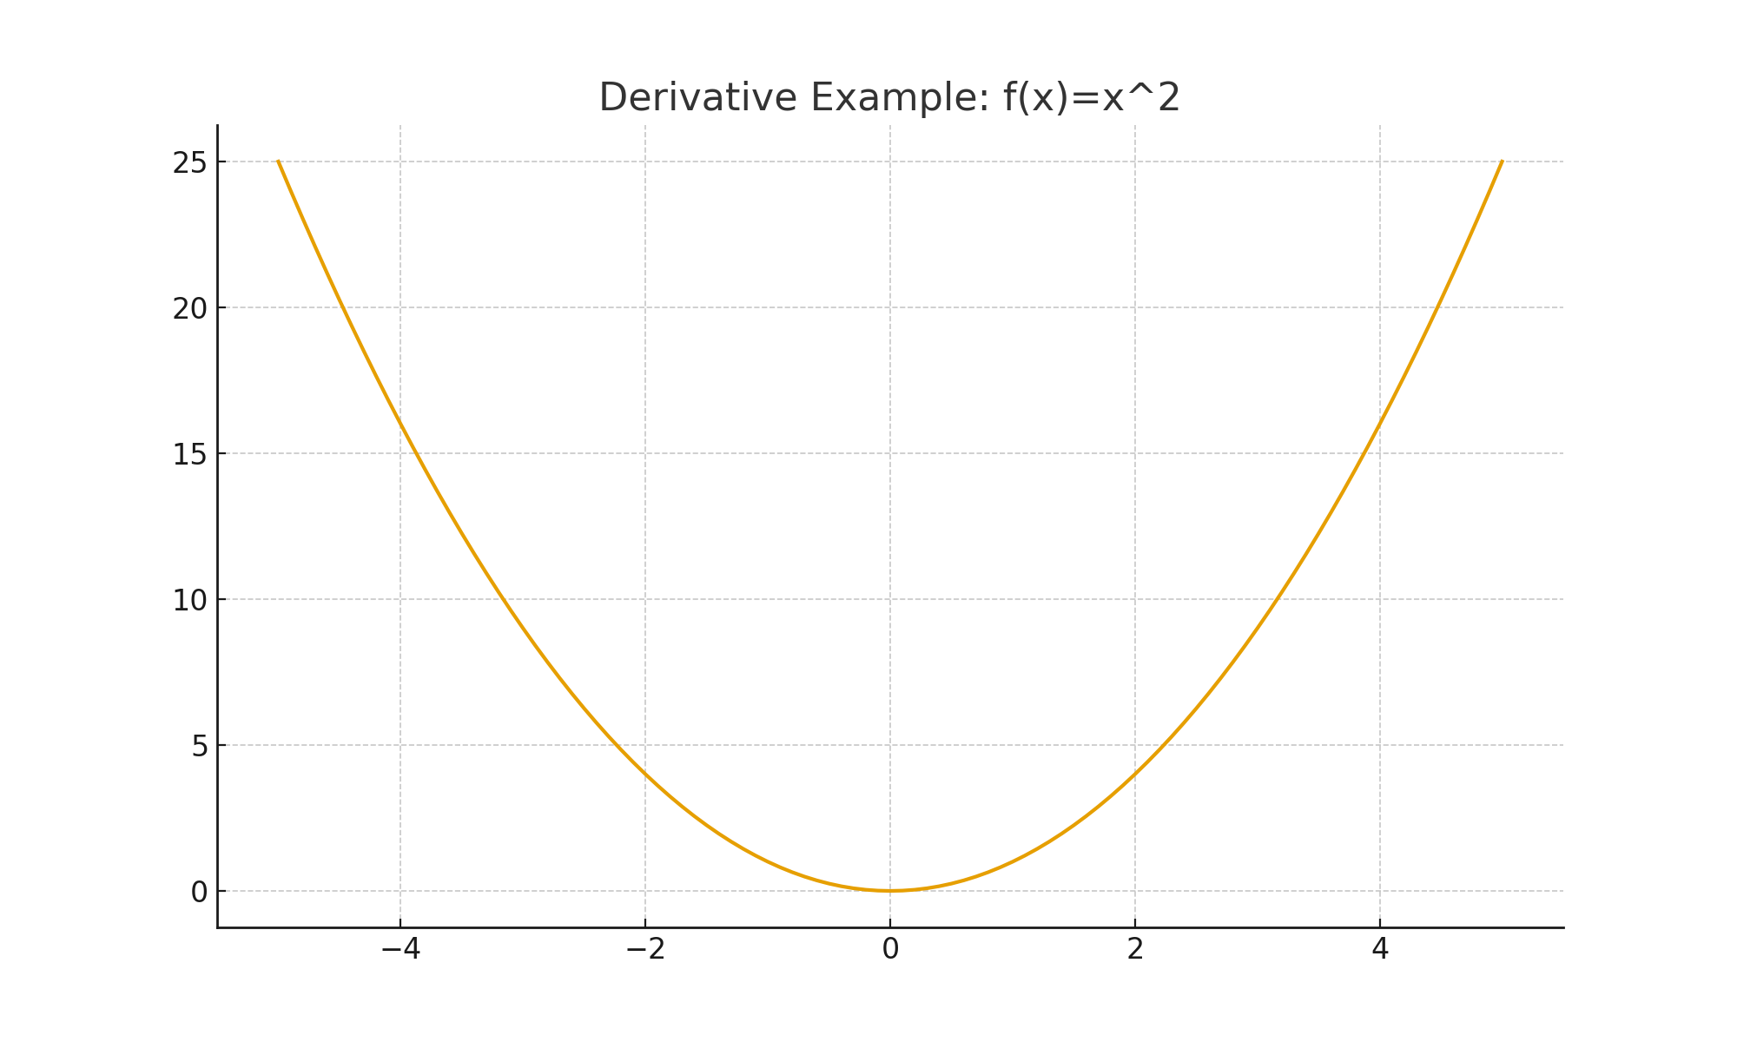
Differential Calculus — Slide 21
  Graph Interpretation:
  Slope of tangent = instantaneous change.
  Summary Slide:
  Derivatives measure rate and slope.
  Optimization Overview:
  Using derivatives to maximize/minimize.

Slide 23
Applications of Derivatives — Slide 22
  Critical Numbers:
  Where f'=0 or undefined.
  First Derivative Test:
  Classify critical points.
  Second Derivative Test:
  Concavity-based classification.

Slide 24
Applications of Derivatives — Slide 23
  Application – Revenue:
  Maximizing R(x)=xp(x).
  Application – Cost:
  Marginal cost approximates cost change.
  Application – Profit:
  Maximizing π(x)=R(x)−C(x).

Slide 25
Applications of Derivatives — Slide 24
  Geometry Optimization:
  Max area with fixed perimeter.
  Physics – Velocity:
  Derivative of position.
  Physics – Acceleration:
  Derivative of velocity.

Slide 26
Applications of Derivatives — Slide 25
  Rate of Change Concept:
  Real-world dynamic systems.
  Related Rates (Advanced):
  Differentiate w.r.t time.
  Business Marginal Analysis:
  MC, MR, MP.

Slide 27
Applications of Derivatives — Slide 26
  Tangent Line Application:
  Estimate future values.
  Curve Sketching:
  Use f', f'' to analyze shape.
  Asymptotes:
  Using limits + derivatives.

Slide 28
Applications of Derivatives — Slide 27
  Maximum Profit Example:
  Find x where π'(x)=0.
  Optimization in Economics:
  Utility maximization.
  Engineering Applications:
  Stress, strain modeling.

Slide 29
Applications of Derivatives — Slide 27
  Biology Applications:
  Population growth rates.
  Concavity and Graph Shape:
  Determines 'bending'.
  Global vs Local Extrema:
  Closed interval testing.

Slide 30
Applications of Derivatives — Slide 28
  Mean Value Theorem:
  Slope of secant equals slope of tangent.
  Derivative-Based Motion:
  Distance, speed, jerk.
  Summary Slide:
  Derivatives describe change & optimization.

Slide 31
Integral Calculus — Slide 29
  Definition of an Integral:
  Accumulated area under curve.
  Indefinite Integrals:
  Antiderivatives + C.
  Basic Rules:
  ∫x^n dx=x^(n+1)/(n+1)+C.

Slide 32
Integral Calculus — Slide 30
  Constant Rule:
  ∫c dx=cx+C.
  Sum Rule:
  Integrate term-by-term.
  Substitution Rule:
  Reverse chain rule.

Slide 33
Integral Calculus — Slide 31
  Integration by Parts:
  ∫udv=uv−∫vdu.
  Integrating Rational Functions:
  Partial fractions.
  Trigonometric Integrals:
  Useful identities.

Slide 34
Integral Calculus — Slide 32
  Definite Integrals:
  Compute exact area.
  Area Under Curve:
  Definite integral meaning.
  Signed Area:
  Area can be negative.

Slide 35
Integral Calculus — Slide 33
  Fundamental Theorem Part 1:
  Derivative of integral returns integrand.
  Fundamental Theorem Part 2:
  Evaluate definite integrals.
  Improper Integrals:
  Infinite bounds.

Slide 36
Integral Calculus — Slide 34
  Numerical Integration:
  Trapezoidal rule.
  Average Value of a Function:
  (1/(b−a))∫ f(x) dx.
  Physical Applications:
  Work, energy.

Slide 37
Integral Calculus — Slide 35
  Probability Applications:
  Integrals for continuous distributions.
  Accumulation Functions:
  F(x)=∫ f(t) dt.
  Area Between Curves:
  Subtract integrals.

Slide 38
Integral Calculus — Slide 36
  Volume by Rotation:
  Disk and shell methods.
  Arc Length Formula:
  Integral of √(1+(f’)^2).
  Surface Area of Solids:
  Using integrals.

Slide 39
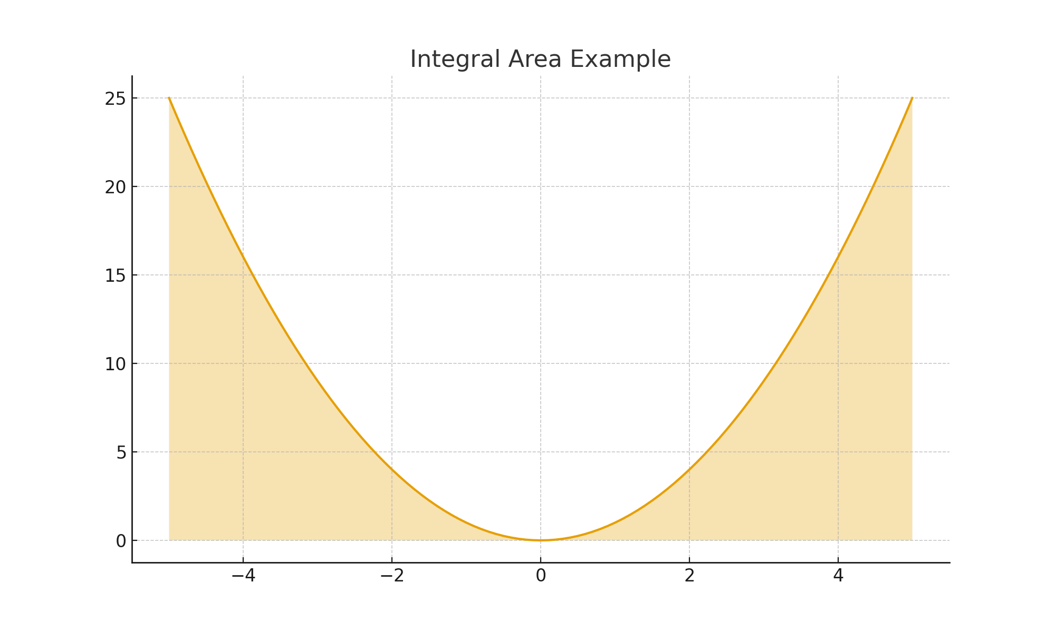
Integral Calculus — Slide 37
  Summary Slide:
  Integration = accumulation.

